Slide 1
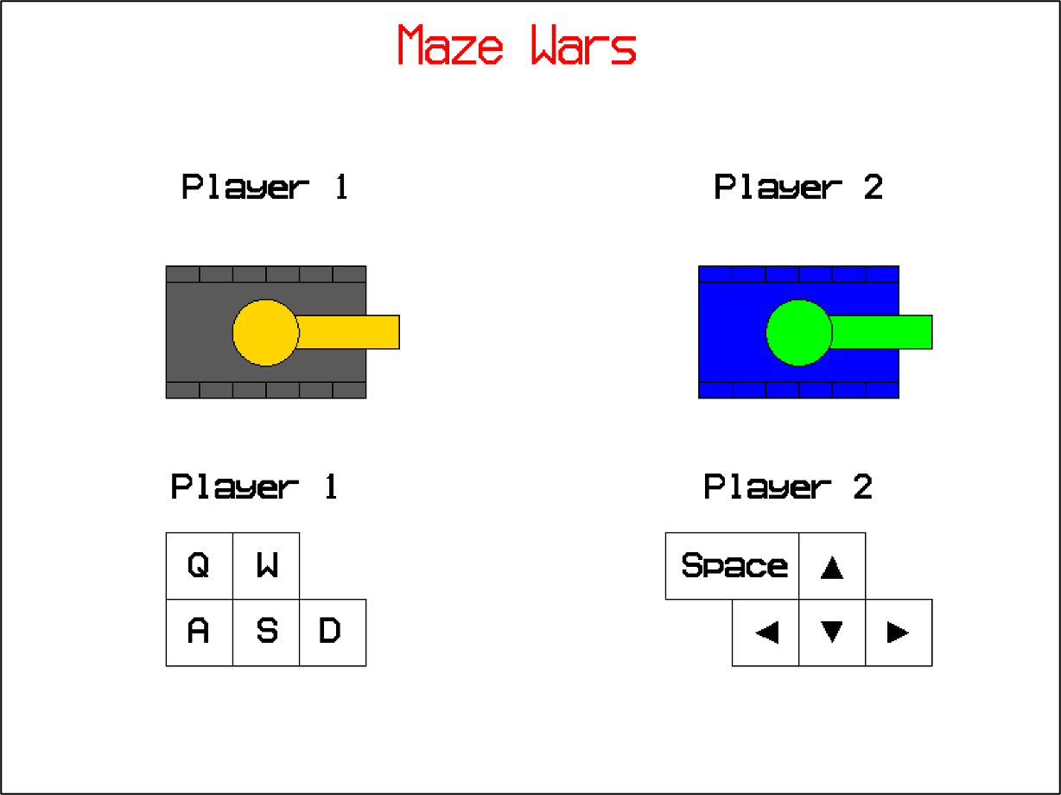
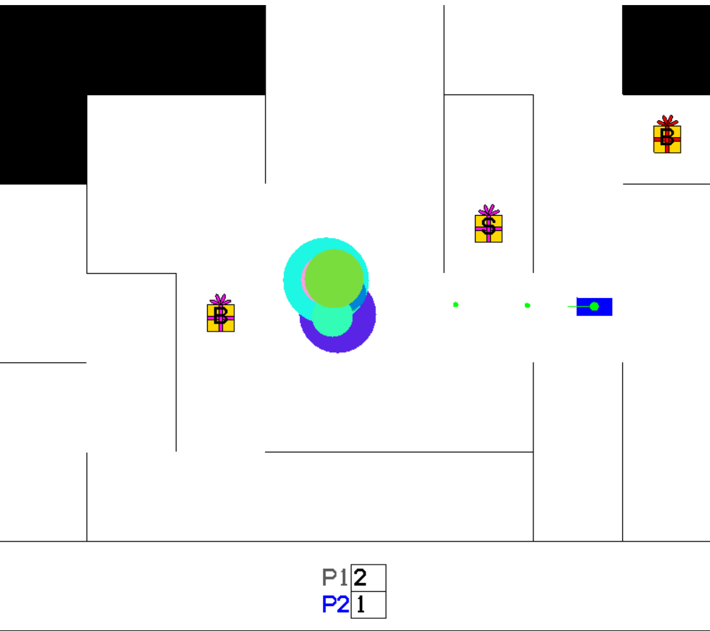


Team Fantastic
Main Menu
Game Clip
Bonus Items:
B,S
B,S,N

